Slide 1
ICT 2103 Digital Logic Design
Prof. Dr. Muhammad Shahin Uddin

Slide 2
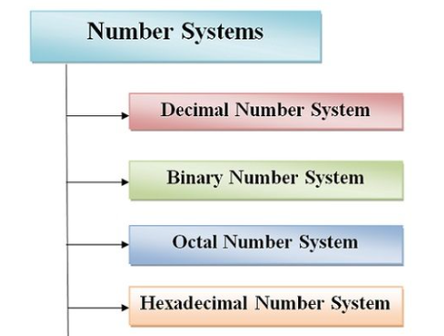
Number System
Non-Positioned Number System
Roman Number
I = 1, V = 5, X = 10, L = 50, C = 100, D = 500, M = 1000.
Positioned Number System
1999 is MCMXCIX, or M (1000) + CM (1000-100) + XC (100-10) + IX (10-1).

Slide 3
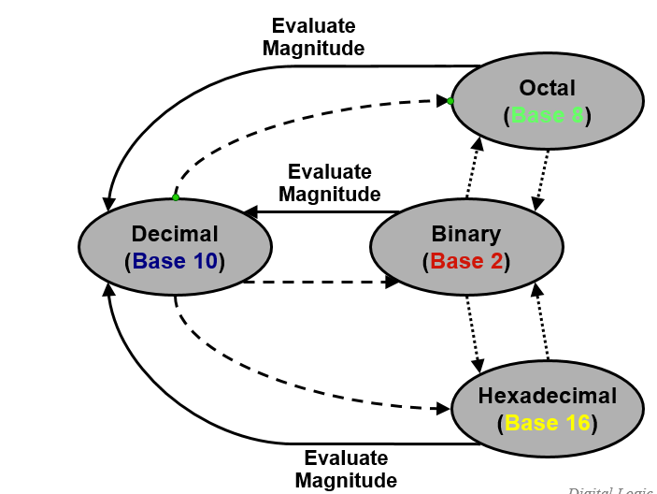
Number Base Conversions

Slide 4
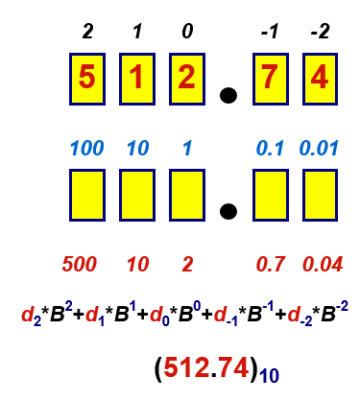
Decimal Number System
Base (also called radix) = 10
10 digits { 0, 1, 2, 3, 4, 5, 6, 7, 8, 9 }
Digit Position
Integer & fraction
Digit Weight
Weight = (Base) ^{Position}
Magnitude
Sum of “Digit x Weight”
Formal Notation

Slide 5
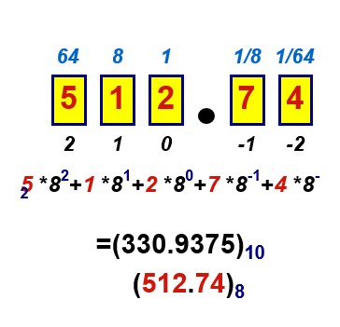
Octal Number System
Base = 8
8 digits { 0, 1, 2, 3, 4, 5, 6, 7 }
Weights
Weight = (Base) ^{Position}
Magnitude
Sum of “Digit x Weight”
Formal Notation

Slide 6
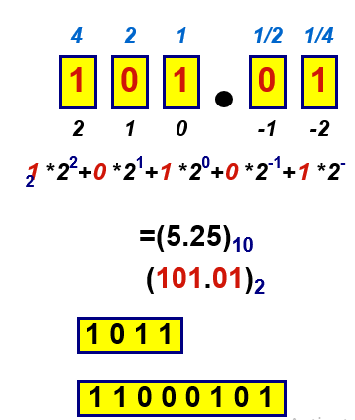
Binary Number System
Base = 2
2 digits { 0, 1 }, called binary digits or “bits”
Weights
Weight = (Base) ^{Position}
Magnitude
Sum of “Bit x Weight”
Formal Notation
Groups of bits
8 bits = Byte

Slide 7
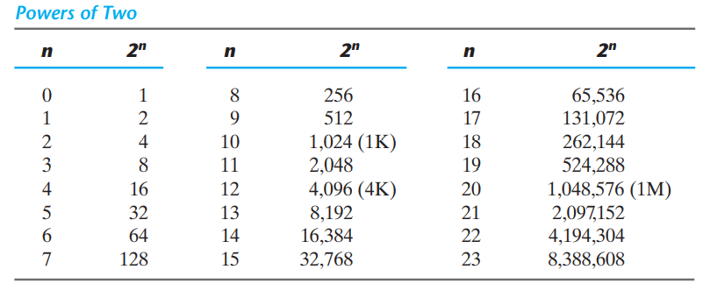
Binary Number

Slide 8
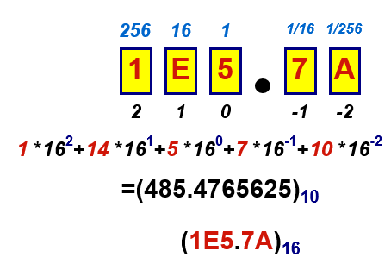
Hexadecimal Number System
Base = 16
16 digits { 0, 1, 2, 3, 4, 5, 6, 7, 8, 9, A, B, C, D, E, F }
Weights
Weight = (Base) ^{Position}
Magnitude
Sum of “Digit x Weight”
Formal Notation

Slide 9
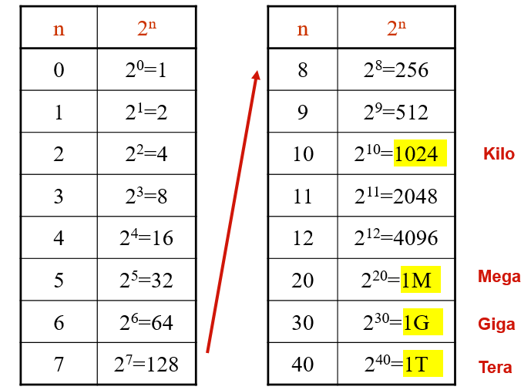
The Power of 2

Slide 10
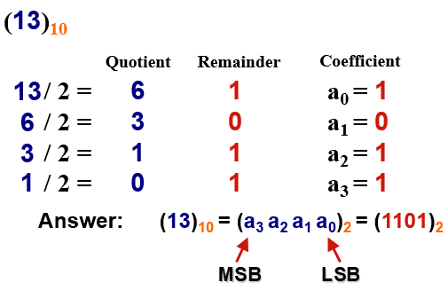
1.1a Decimal (Integer) to Binary Conversion
Divide the number by the ‘Base’ (=2)
Take the remainder (either 0 or 1) as a coefficient
Take the quotient and repeat the division
Example:

Slide 11
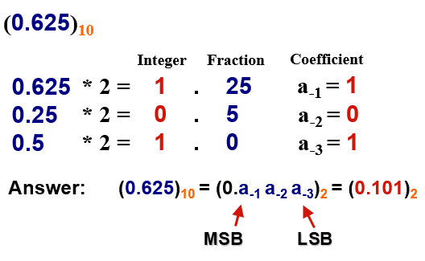
1.1b Decimal (Fraction) to Binary Conversion
Multiply the number by the ‘Base’ (=2)
Take the integer (either 0 or 1) as a coefficient
Take the resultant fraction and repeat the division
Example:

Slide 12
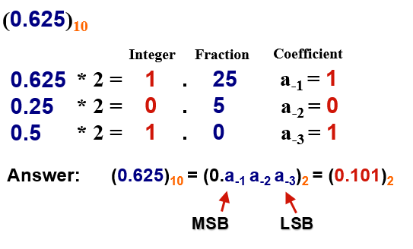
1.1c Decimal (Fraction) to Binary Conversion
Multiply the number by the ‘Base’ (=2)
Take the integer (either 0 or 1) as a coefficient
Take the resultant fraction and repeat the division
Example:

Slide 13
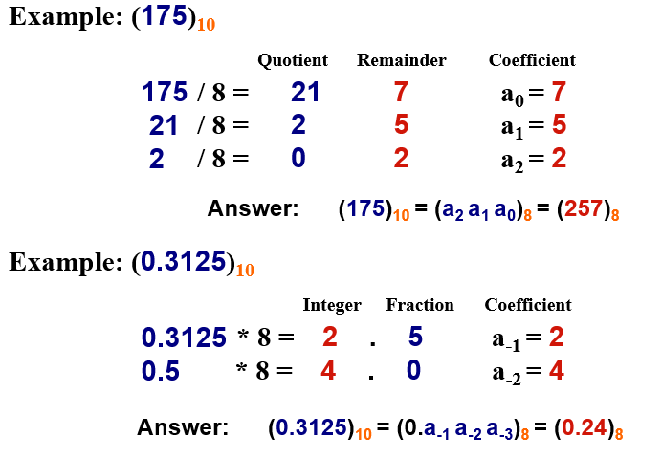
2.1. Decimal to Octal Conversion

Slide 14
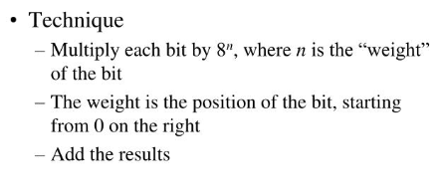
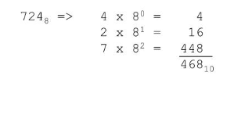
2.2. Octal to Decimal Conversion
Example:

Slide 15
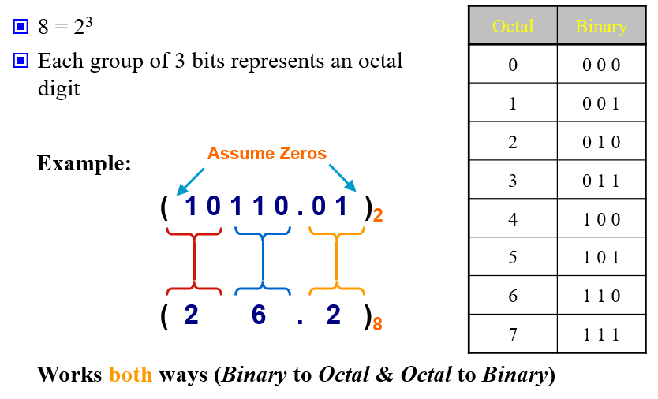
3.1. Binary− Octal Conversion

Slide 16
3.2. Octal-to-Binary Conversion
Because each octal digit can be represented by a 3-bit binary number, it is very easy to convert from octal to binary..
Octal/Binary Conversion
Octal Digit 0 1 2 3 4 5 6 7
Binary 000 001 010 011 100 101 110 111
Let’s convert the octal numbers 25 and 140.
2 5 1 4 0
010 101 001 100 000

Slide 17
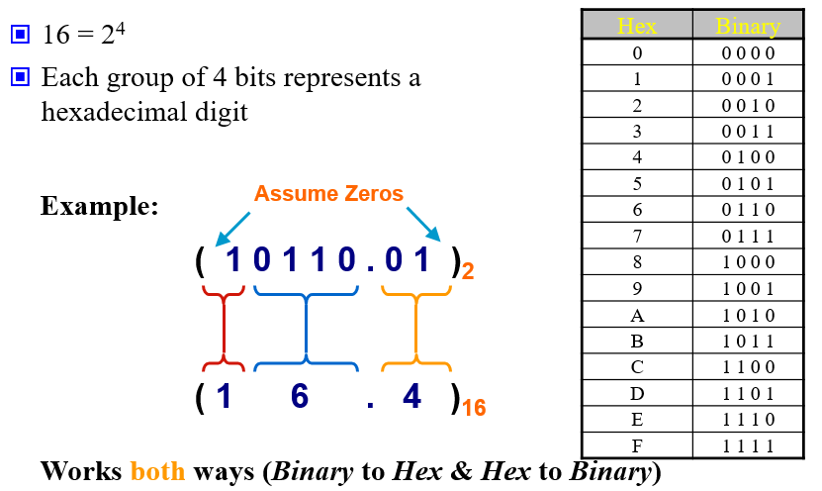
4.1 Binary−Hexadecimal Conversion
Prof. Dr. Muhammad Shahin Uddin
Email: muhammad.uddin@northsouth.edu
Out
Ashraful.sarker@nort

Slide 18
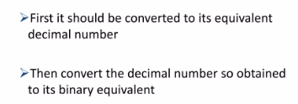
4.1 Hexadecimal to Binary Conversion
Method 1

Slide 19
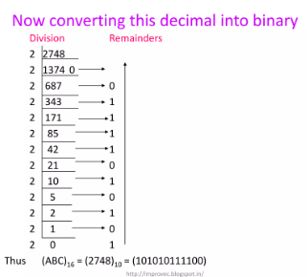

Method 1: Example

Slide 20
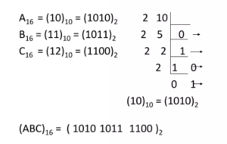
Method 2
Each digit of the given hexadecimal number should be converted to its 4 bit binary equivalent

Slide 21
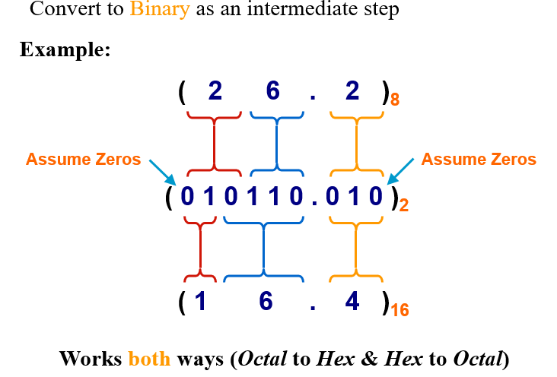
5.1 Octal−Hexadecimal Conversion

Slide 22
5.2 Hexadecimal to Octal Conversion

Slide 23
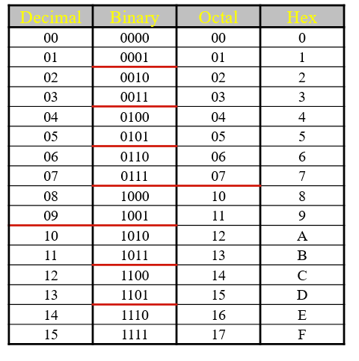
Decimal, Binary, Octal and Hexadecimal

Slide 24
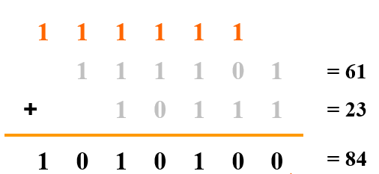
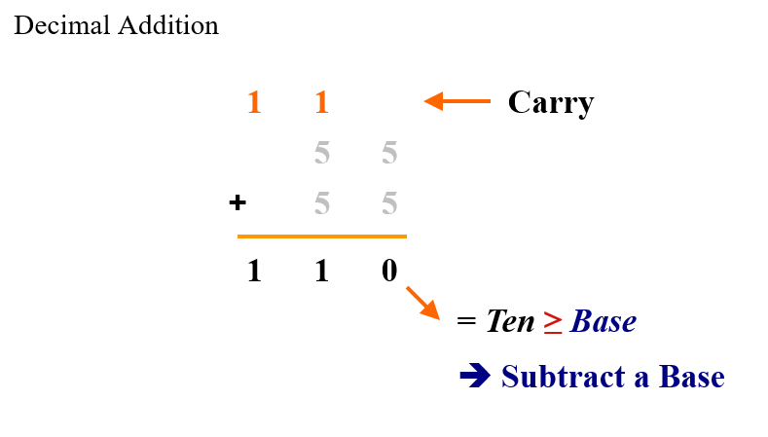
Addition
Decimal Binary

Slide 25
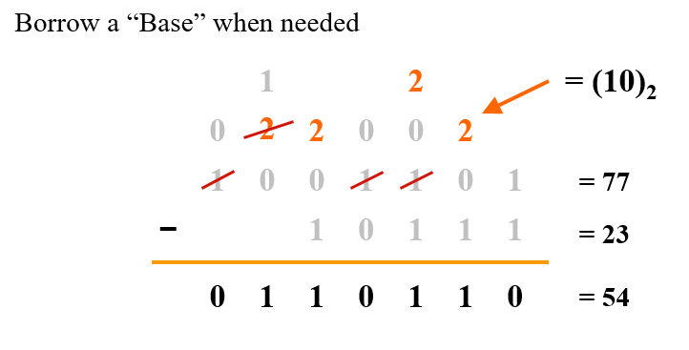
Binary Subtraction

Slide 26
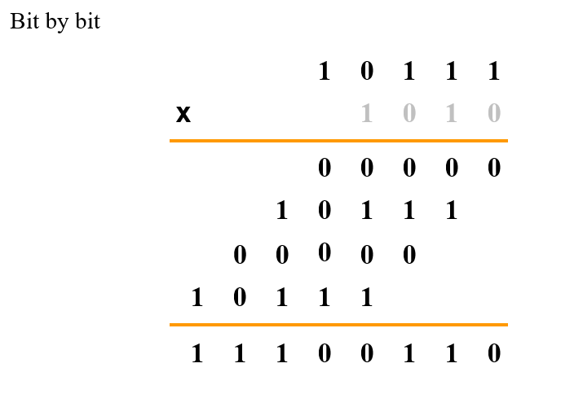
Binary Multiplication

Slide 27
Base Conversion
Examples:
(11010)₂ =( ? )₁₀
N = 1´2⁴ + 1´2³ + 0´2² + 1´2¹ + 0´2⁰
= (16)₁₀ + (8)₁₀ + 0 + (2)₁₀ + 0
= (26)₁₀
(627)₈ = ( ? )₁₀
N = 6´8² + 2´8¹ + 7´8⁰
= (384)₁₀ + (16)₁₀ + (7)₁₀
= (407)₁₀

Slide 28
Base Conversion
Examples:
(11010)₂ =( ? )₁₀
N = 1´2⁴ + 1´2³ + 0´2² + 1´2¹ + 0´2⁰
= (16)₁₀ + (8)₁₀ + 0 + (2)₁₀ + 0
= (26)₁₀
(627)₈ = ( ? )₁₀
N = 6´8² + 2´8¹ + 7´8⁰
= (384)₁₀ + (16)₁₀ + (7)₁₀
= (407)₁₀

Slide 29
Base Conversion
(11010)₂ →( ? )₁₀
N = 1×2⁴ + 1×2³ + 0×2² + 1×2¹ + 0×2⁰
= (16)₁₀ + (8)₁₀ + 0 + (2)₁₀ + 0
= (26)₁₀
(627)₈ → ( ? )₁₀
N = 6×8² + 2×8¹ + 7×8⁰
= (384)₁₀ + (16)₁₀ + (7)₁₀
= (407)₁₀

Slide 30
Base Conversion
(11010)₂ →( ? )₁₀
N = 1×2⁴ + 1×2³ + 0×2² + 1×2¹ + 0×2⁰
= (16)₁₀ + (8)₁₀ + 0 + (2)₁₀ + 0
= (26)₁₀
(627)₈ → ( ? )₁₀
N = 6×8² + 2×8¹ + 7×80
= (384)10 + (16)10 + (7)10
= (407)10

Slide 31
Examples of Base Conversion (3)
(315)₁₀ = (473)₈
(315)₁₀ = (13B)₁₆

Slide 32
Examples of Base Conversion (3)
(315)₁₀ = (473)₈
(315)₁₀ = (13B)₁₆

Slide 33
Base Conversion (5)
(0.479)₁₀ = (0.3651…)₈
MSD 3.832 ← 0.479 × 8
6.656 ← 0.832 × 8
5.248 ← 0.656 × 8
LSD 1.984 ← 0.248 × 8
…
(0.479)₁₀ = (0.0111…)₂
MSD 0.9580 ← 0.479 × 2
1.9160 ← 0.9580 × 2
1.8320 ← 0.9160 × 2
LSD 1.6640 ← 0.8320 × 2
…

Slide 34
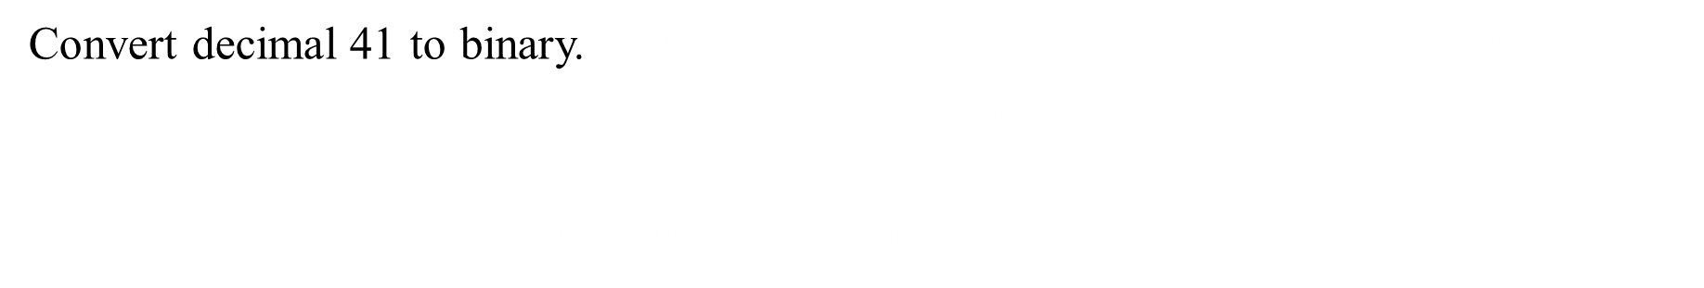
Example 1
Convert decimal 41 to binary. First, 41 is divided by 2 to give an integer quotient of 20 and a remainder of $\frac{1}{2}$. Then the quotient is again divided by 2 to give a new quotient and remainder. The process is continued until the integer quotient becomes 0. The coefficients of the desired binary number are obtained from the remainders as follows:

Slide 35
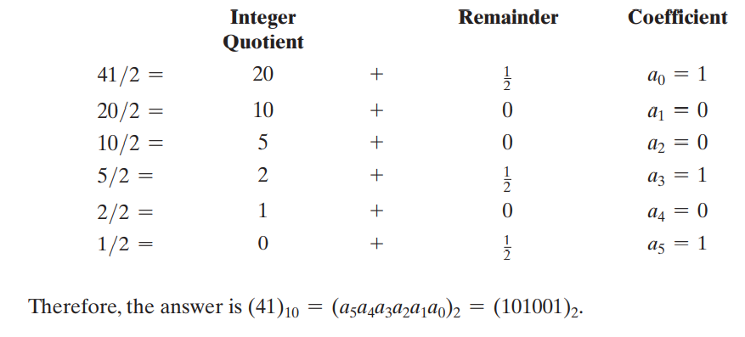

Example 1
Convert decimal 41 to binary. First, 41 is divided by 2 to give an integer quotient of 20 and a remainder of $\frac{1}{2}$. Then the quotient is again divided by 2 to give a new quotient and remainder. The process is continued until the integer quotient becomes 0. The coefficients of the desired binary number are obtained from the remainders as follows:

Slide 36
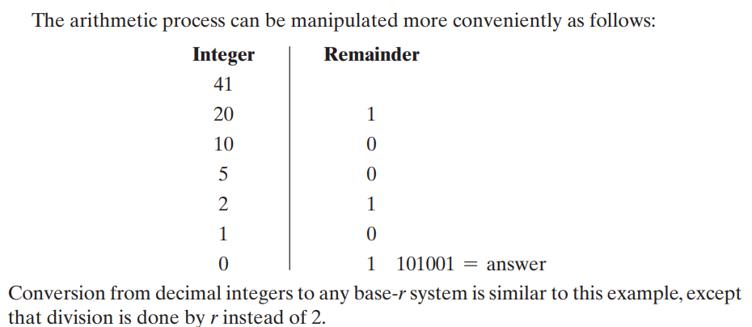
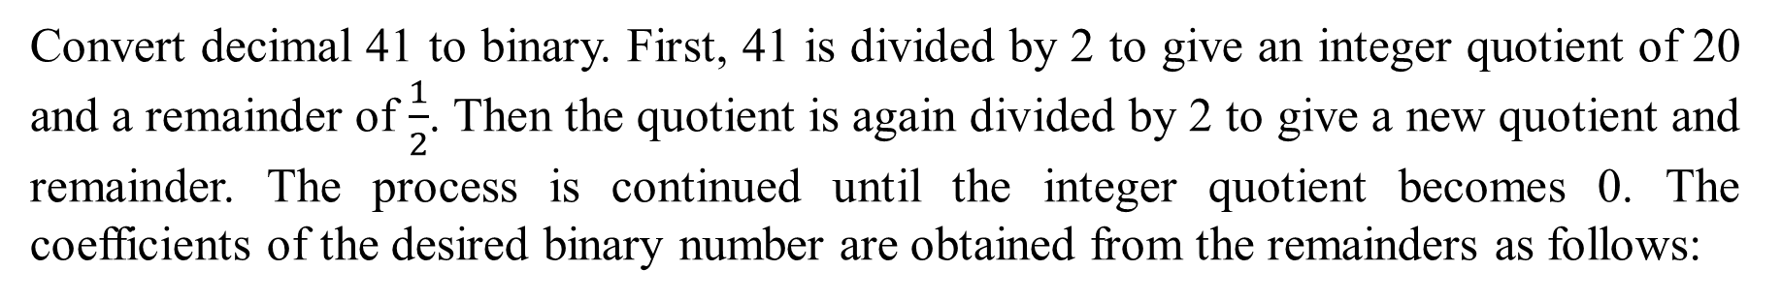
Example 1
Convert decimal 41 to binary. First, 41 is divided by 2 to give an integer quotient of 20 and a remainder of $\frac{1}{2}$. Then the quotient is again divided by 2 to give a new quotient and remainder. The process is continued until the integer quotient becomes 0. The coefficients of the desired binary number are obtained from the remainders as follows:

Slide 37
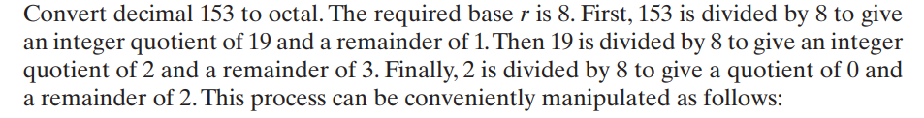
Example 2

Slide 38
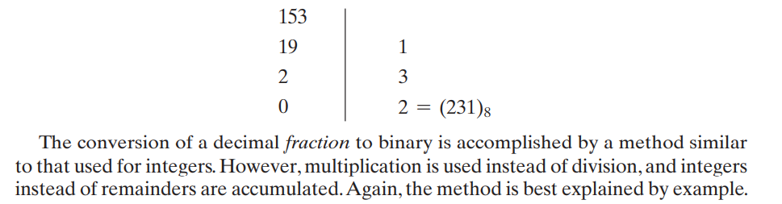
Example 2

Slide 39
Thanks

